Slide 1
“It’s Not a Bug, It’s a Feature”
Advisor Meeting Two

Slide 2
key decisions & achievements
Completed from last meeting's plan
Finalized Requirements
Decided on GitHub Workflow (Branching/Issues)
Mostly Complete Epic One’s and Partially Complete Two’s Functionality
Decided on Google Maps API
Prototypes
UI
TFL
Navigation
Mapping
Firebase / Login
Formal UI Documentation and Standardization
Integration and Standardization of Prototypes into Central Project

Slide 3
current challenges
Technical Debt from not Implementing Automated Testing
Question:
Can we delete branches or are they required for marking?

Slide 4
two weeks plan
Generate Timeline for the Remainder of the Project
Implement an Automated Testing Suite
Finalize Epic One & Two Functionality
Stabilization & Bug Fixes
Produce ”Release" Version 1.0

Slide 5
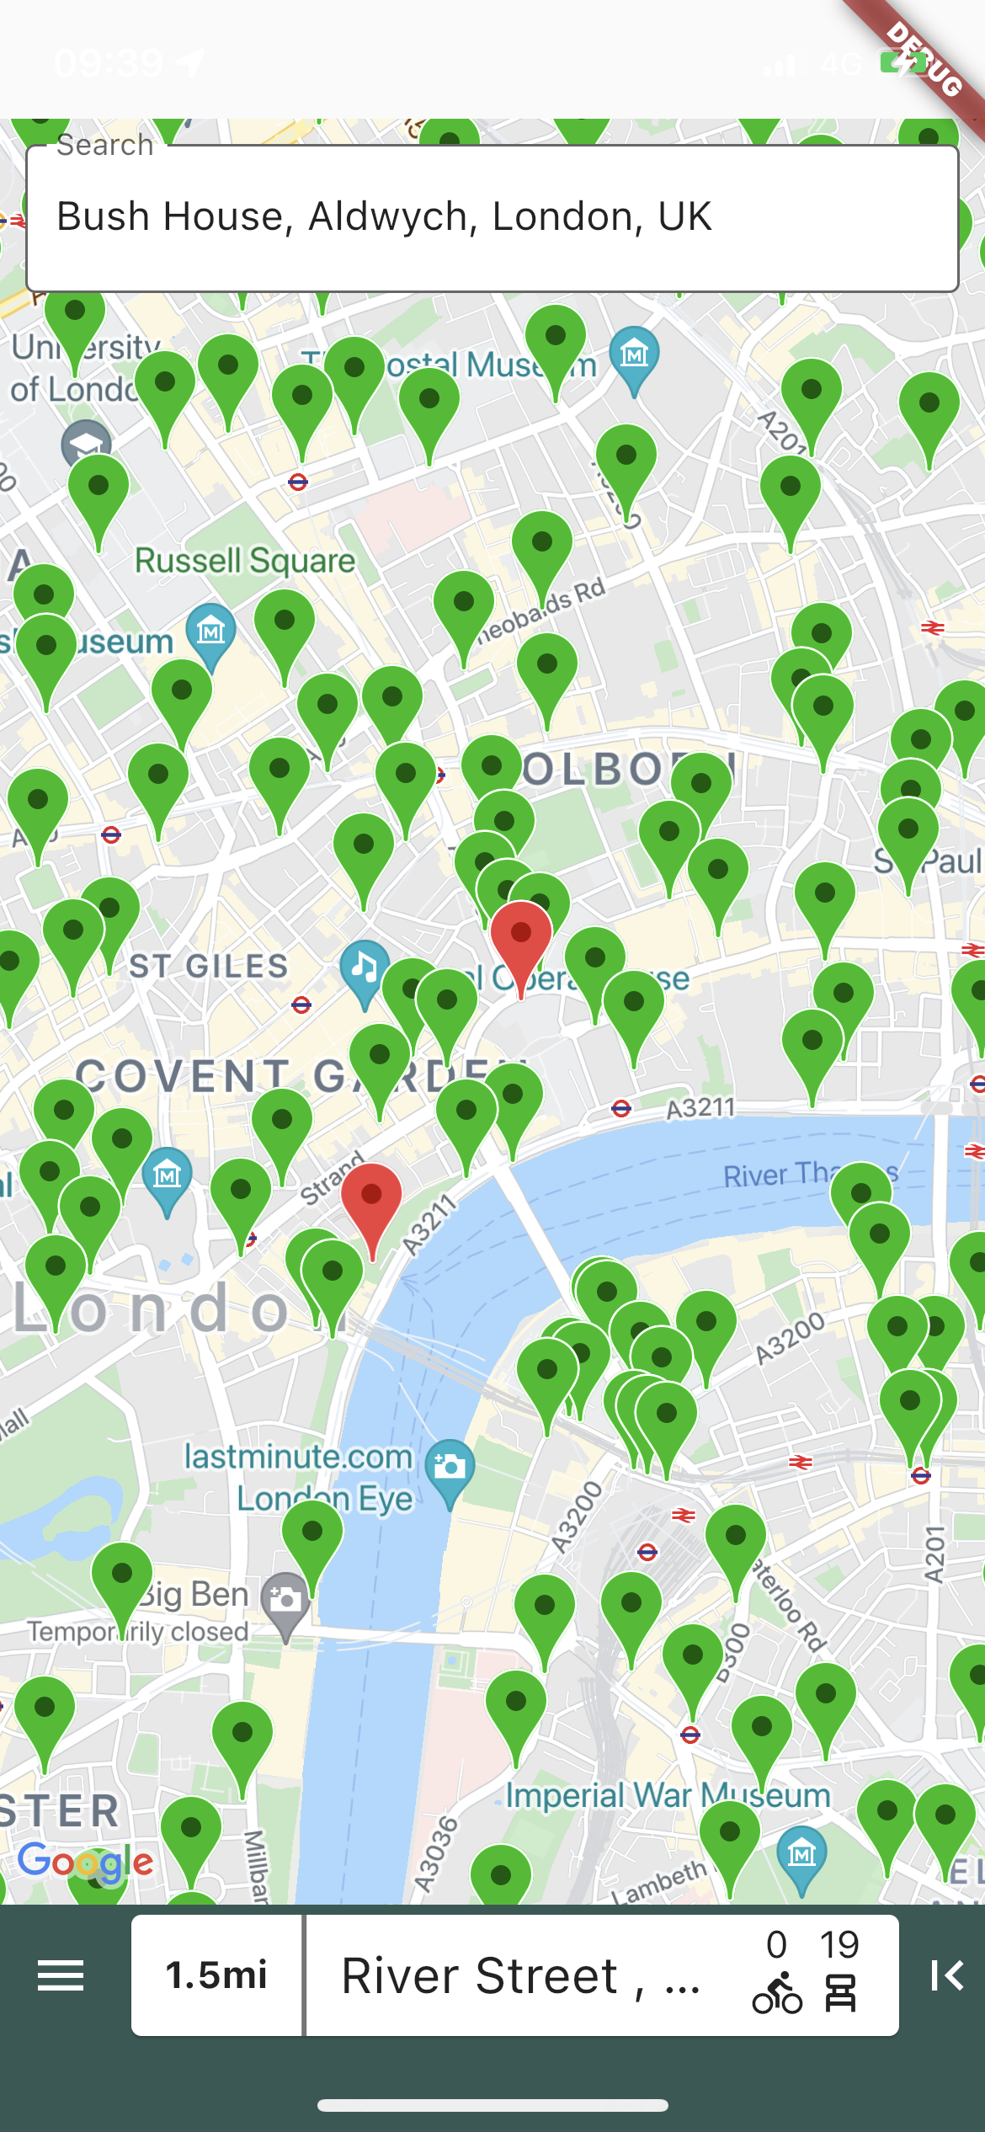
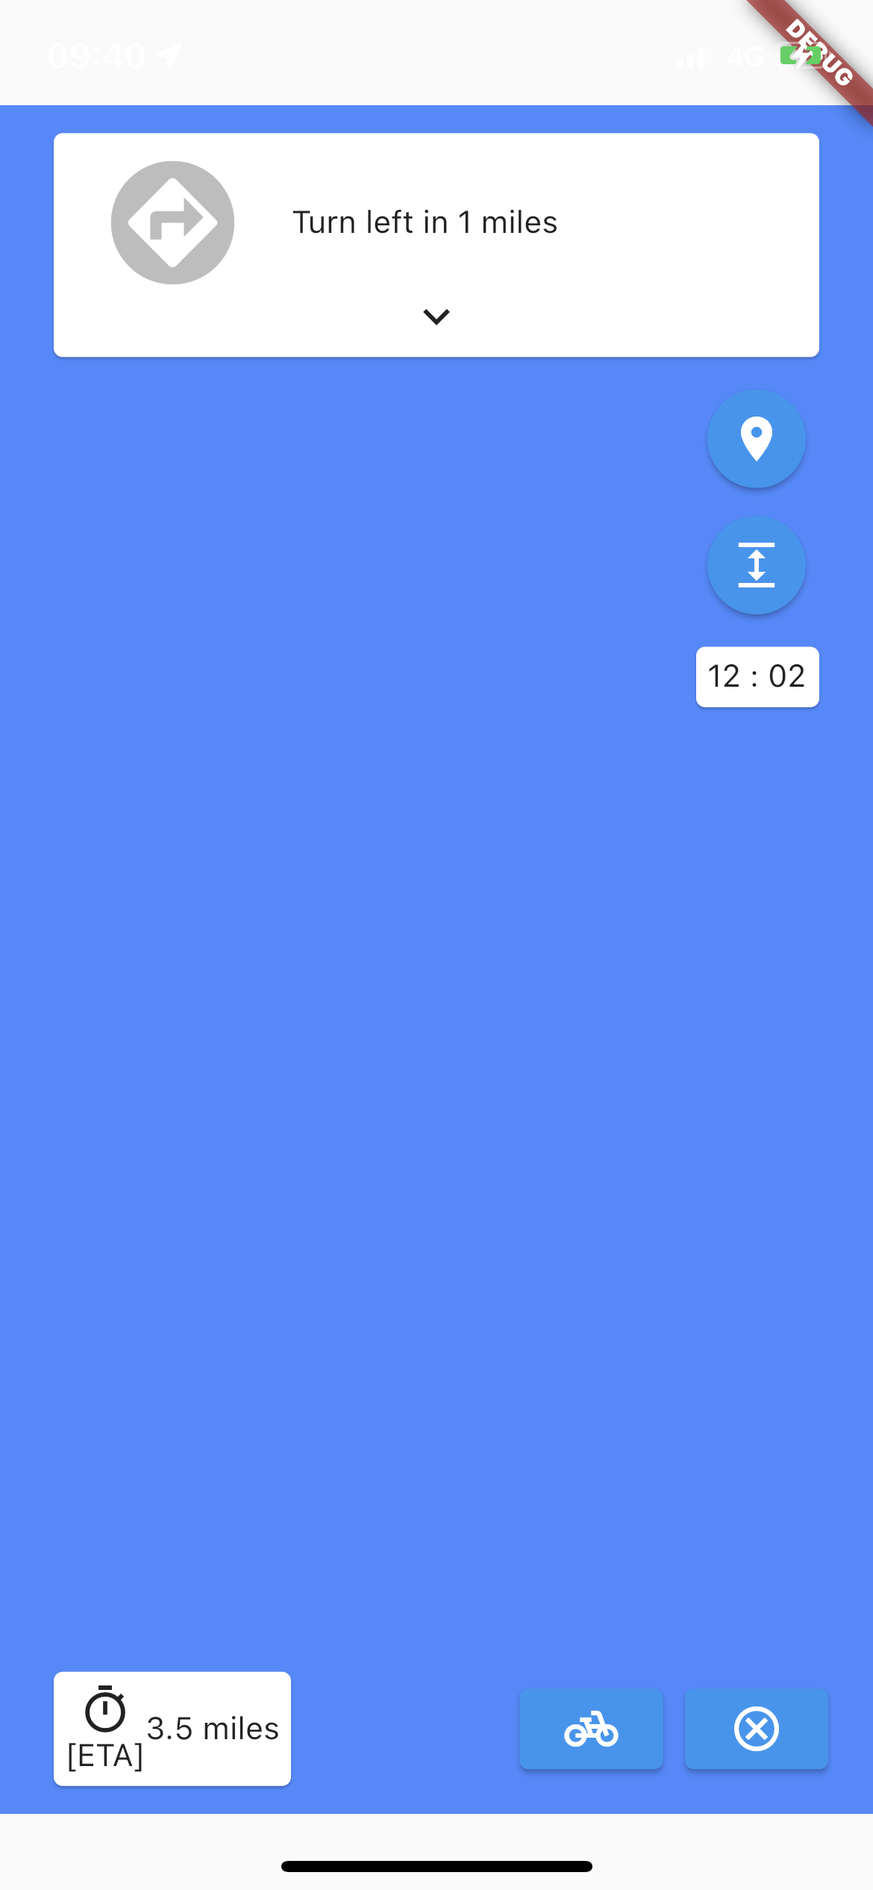
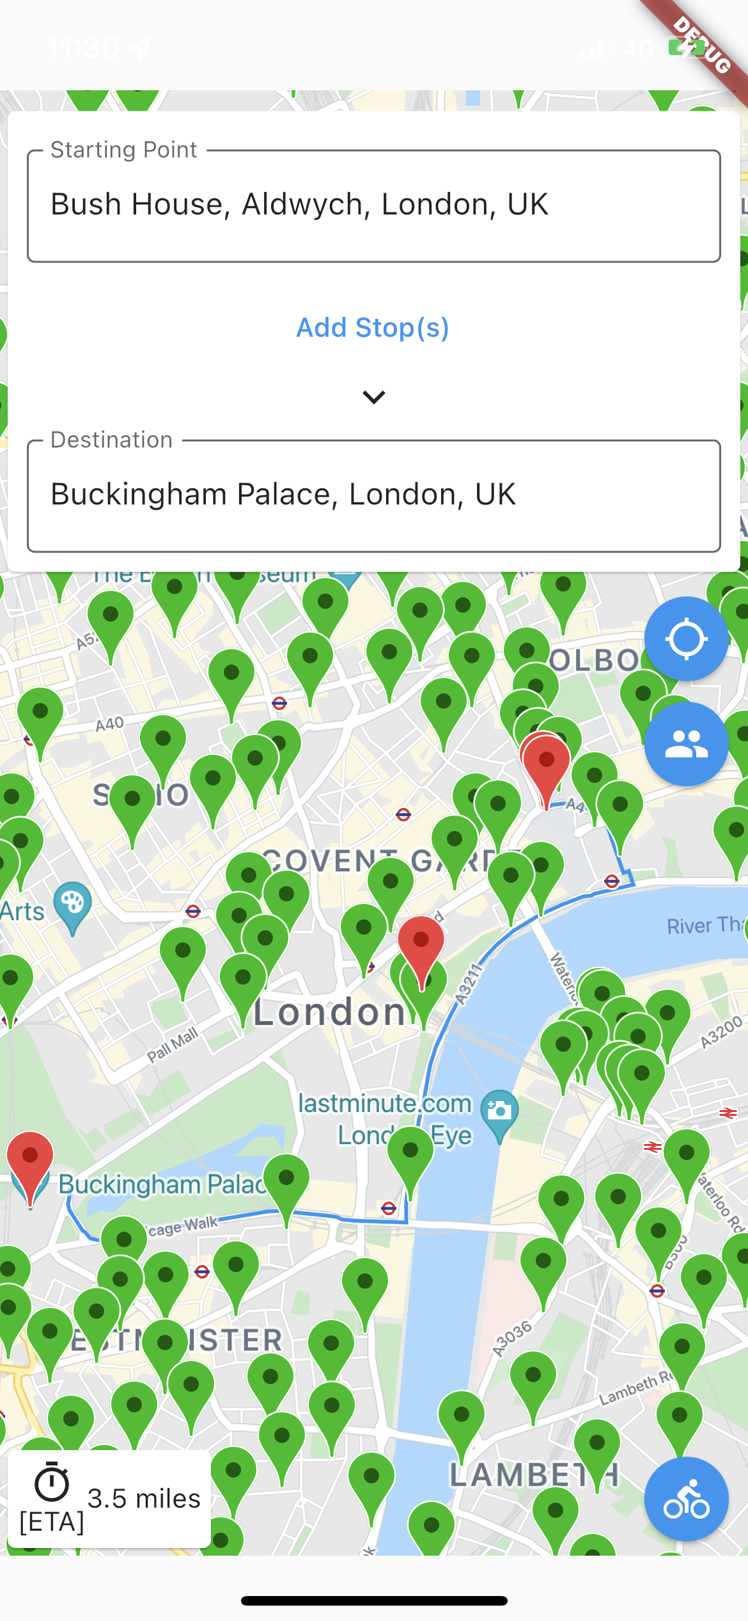
Current Application UI
Home Page
Navigation Page
Route Planning Page

Slide 6
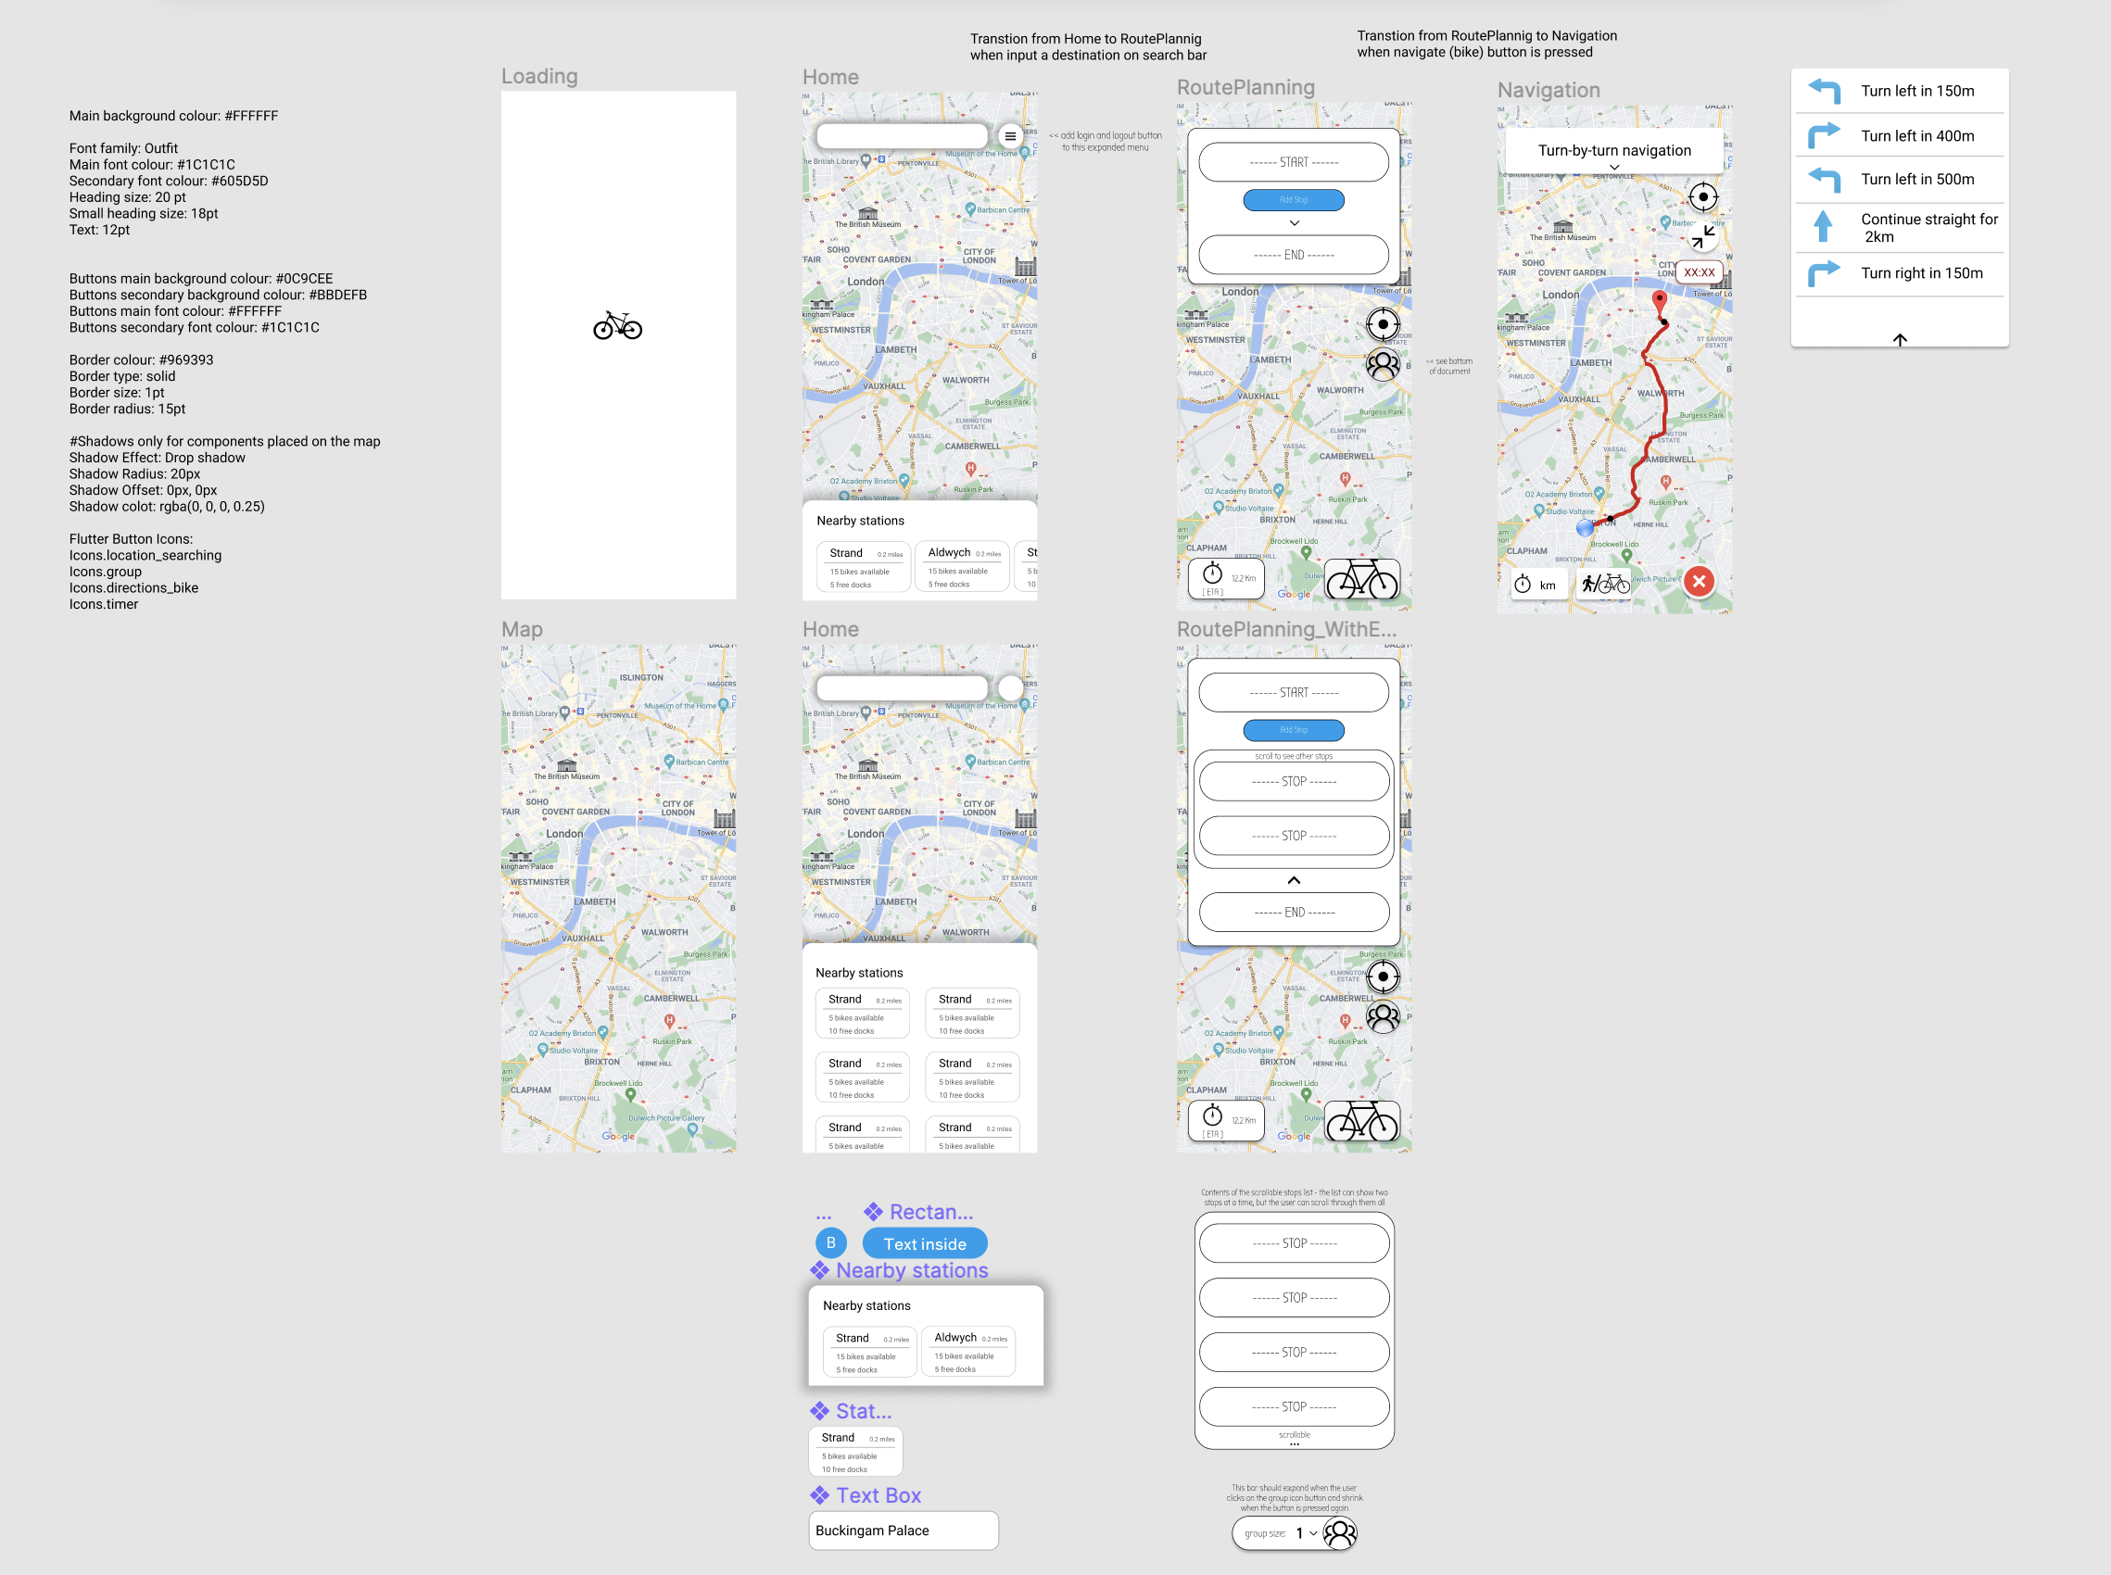
UI Standardization

Slide 7
The End

